Slide 1

Trees
CS 2321
Data Structures and Algorithms
Dr. Mahdi Khemakhem

Slide 2
Outlines
Definitions and Terminologies
Binary Trees
Binary Search Trees
AVL-Trees

Slide 3
1. Defintions and Terminoligies
Reading: Text Book (Weiss) 4.1

Slide 4
Trees
Logarithm access time of linked lists is prohibitive
Does there exist any simple data structure for which the running time of most operations (search, insert, delete) is O(log N)?

Slide 5
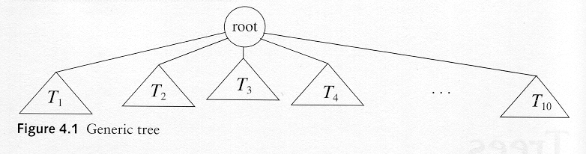
Trees
A tree is a collection of nodes
The collection can be empty
(recursive definition) If not empty, a tree consists of a distinguished node r (the root), and zero or more nonempty subtrees T₁, T₂, ...., T_{k}, each of whose roots are connected by a directed edge from r

Slide 6
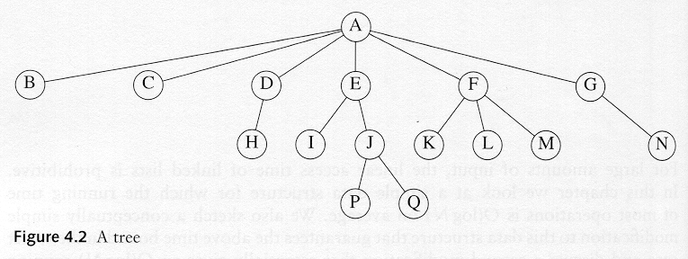
Some Terminologies
Child and parent
Every node except the root has one parent
A node can have an arbitrary number of children
Leaves
Nodes with no children
Sibling
nodes with same parent

Slide 7
Some Terminologies
Path from node n₁ to n_{k} is defined as a sequence of nodes n₁, n₂, . . . , n_{k} such that n_{i} is the parent of n_{i+1} for 1 ≤ i < k.
Length of a path: number of edges on the path
Depth of a node: is the length of the unique path from the root to that node
Depth of a tree: is equal to the depth of the deepest leaf
Height of a node: is the length of the longest path from that node to a leaf
all leaves are at height 0
The height of a tree: is equal to the height of the root
Ancestor and descendant
Proper ancestor and proper descendant

Slide 8
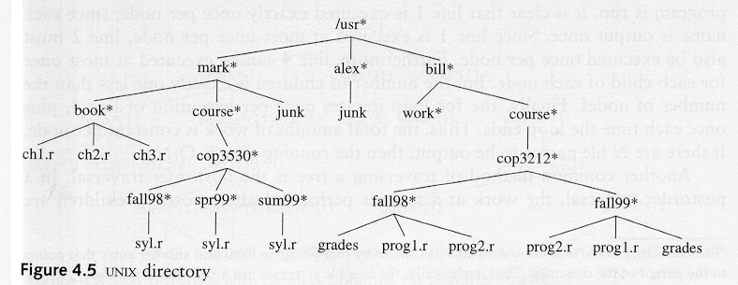
Example: UNIX Directory

Slide 9
2. Binary Trees
Reading: Text Book (Weiss) 4.2

Slide 10
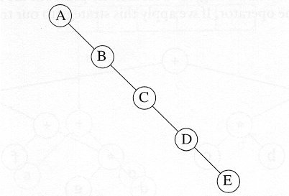
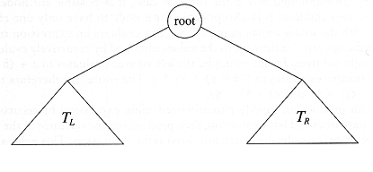
Binary Trees
A tree in which no node can have more than two children
The depth of an “average” binary tree is considerably smaller than N, eventhough in the worst case, the depth can be as large as N – 1.

Slide 11
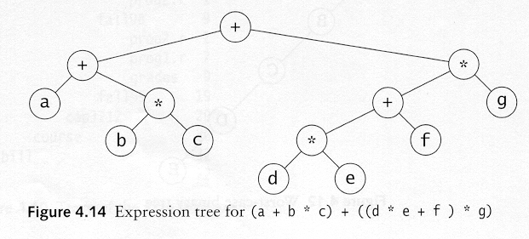
Example: Expression Trees
Leaves are operands (constants or variables)
The other nodes (internal nodes) contain operators
Will not be a binary tree if some operators are not binary

Slide 12
Tree traversal
Used to print out the data in a tree in a certain order
Pre-order traversal
Print the data at the root
Recursively print out all data in the left subtree
Recursively print out all data in the right subtree

Slide 13
Preorder, Postorder and Inorder
Preorder traversal
root, left, right
prefix expression
++a*bc*+*defg

Slide 14
Preorder, Postorder and Inorder
Postorder traversal
left, right, root
postfix expression
abc*+de*f+g*+
Inorder traversal
left, root, right
infix expression
a+b*c+d*e+f*g

Slide 15
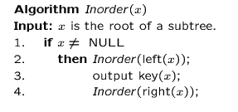
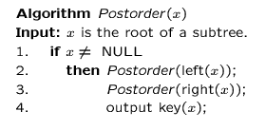
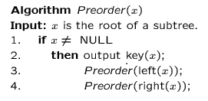
Preorder, Postorder and Inorder

Slide 16
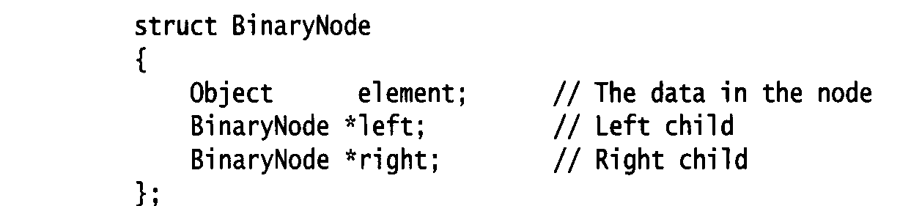
Binary Trees
Possible operations on the Binary Tree ADT
parent
left_child, right_child
sibling
root, etc
Implementation
Because a binary tree has at most two children, we can keep direct pointers to them

Slide 17
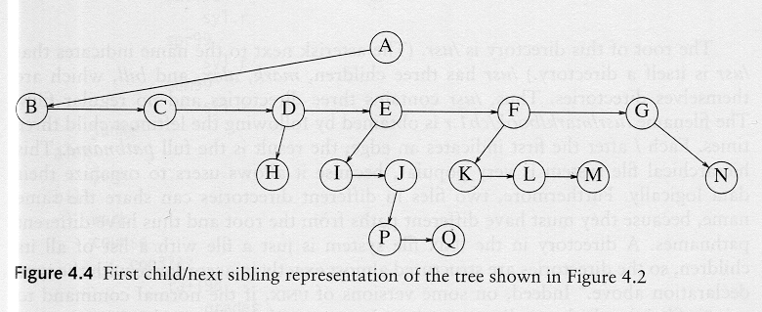
compare: Implementation of a general tree

Slide 18
3. Binary Search Trees
Reading: Text Book (Weiss) 4.3

Slide 19
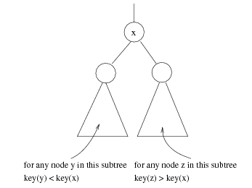
Binary Search Trees
Stores keys in the nodes in a way so that searching, insertion and deletion can be done efficiently.
Binary search tree property
For every node X, all the keys in its left subtree are smaller than the key value in X, and all the keys in its right subtree are larger than the key value in X

Slide 20
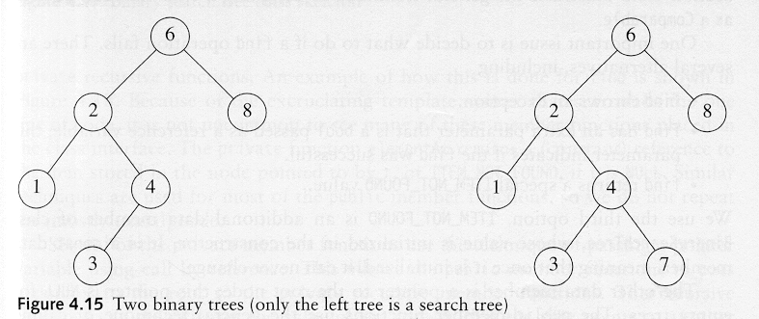
Binary Search Trees
A binary search tree
Not a binary search tree

Slide 21
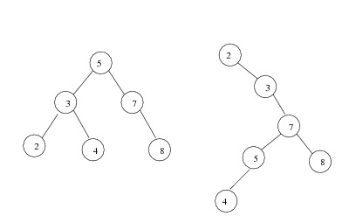
Binary search trees
Two binary search trees representing the same set:
Average depth of a node is O(log N);
Maximum depth of a node is O(N)

Slide 22
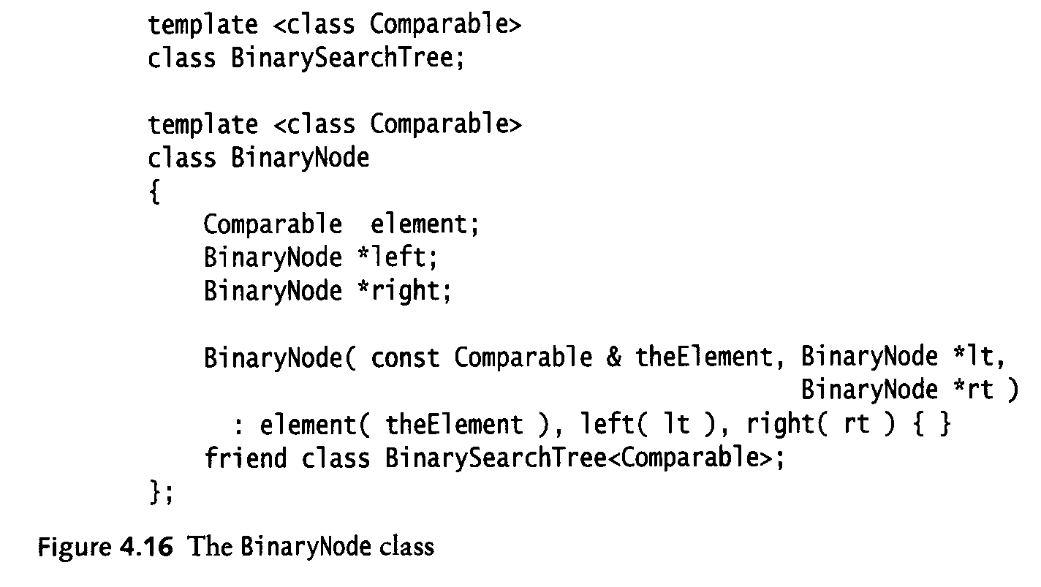
Implementation

Slide 23
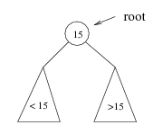
Searching BST
If we are searching for 15, then we are done.
If we are searching for a key < 15, then we should search in the left subtree.
If we are searching for a key > 15, then we should search in the right subtree.

Slide 24
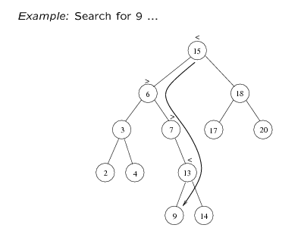
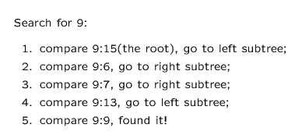

Slide 25
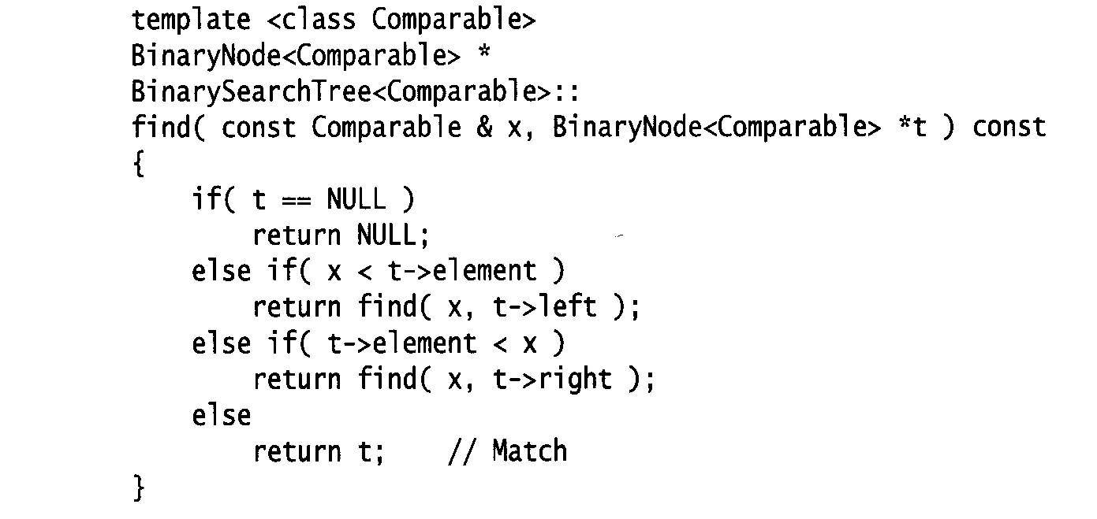
Searching (Find)
Find X: return a pointer to the node that has key X, or NULL if there is no such node
Time complexity
O(height of the tree)

Slide 26
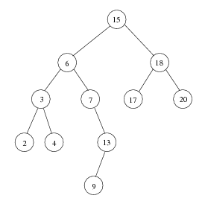
Inorder traversal of BST
Print out all the keys in sorted order
Inorder: 2, 3, 4, 6, 7, 9, 13, 15, 17, 18, 20

Slide 27
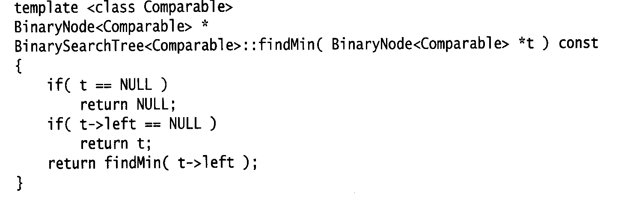
findMin/ findMax
Return the node containing the smallest element in the tree
Start at the root and go left as long as there is a left child. The stopping point is the smallest element
Similarly for findMax
Time complexity = O(height of the tree)

Slide 28
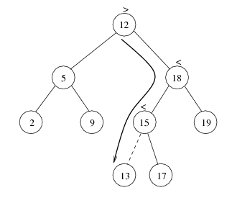
insert
Proceed down the tree as you would with a find
If X is found, do nothing (or update something)
Otherwise, insert X at the last spot on the path traversed
Time complexity = O(height of the tree)

Slide 29
delete
When we delete a node, we need to consider how we take care of the children of the deleted node.
This has to be done such that the property of the search tree is maintained.

Slide 30
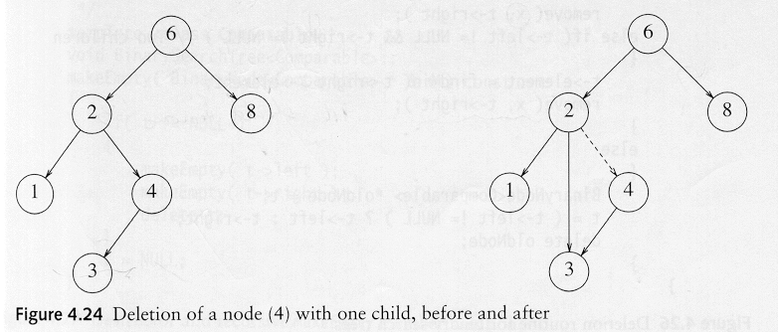
delete
Three cases:
(1) the node is a leaf
Delete it immediately
(2) the node has one child
Adjust a pointer from the parent to bypass that node

Slide 31
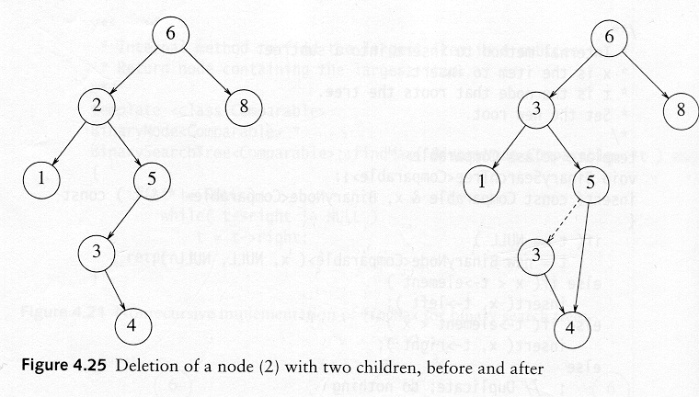
delete
(3) the node has 2 children
replace the key of that node with the minimum element at the right subtree
delete the minimum element
Has either no child or only right child because if it has a left child, that left child would be smaller and would have been chosen. So invoke case 1 or 2.
Time complexity = O(height of the tree)

Slide 32
4. AVL-Trees
Reading: Text Book (Weiss) 4.4

Slide 33
Balanced binary tree
The disadvantage of a binary search tree is that its height can achieve N-1
This means that the time needed to perform insertion and deletion and many other operations can be O(N) in the worst case
We want a tree with small height
A binary tree with N node(s) has height at least O(log N)
Thus, our goal is to keep the height of a binary search tree O(log N)
Such trees are called balanced binary search trees. Examples are AVL tree, Red-black tree.
AVL stands to “Adelson-Velskii and Landis"

Slide 34
AVL tree
Height of a node
The height of a leaf is 1. The height of a null pointer is zero.
The height of an internal node is the maximum height of its children plus 1
Note that this definition of height is different from the one we defined previously (we defined the height of a leaf as zero previously).

Slide 35
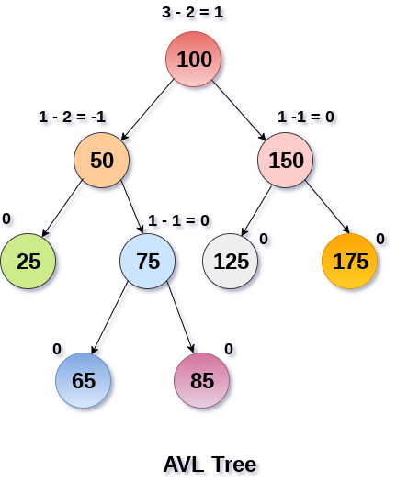

Slide 36
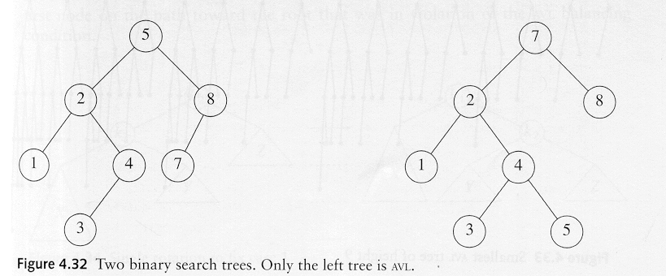
AVL tree
An AVL tree is a binary search tree in which
for every node in the tree, the height of the left and right sub-trees differ by at most 1.
AVL property violated here

Slide 37
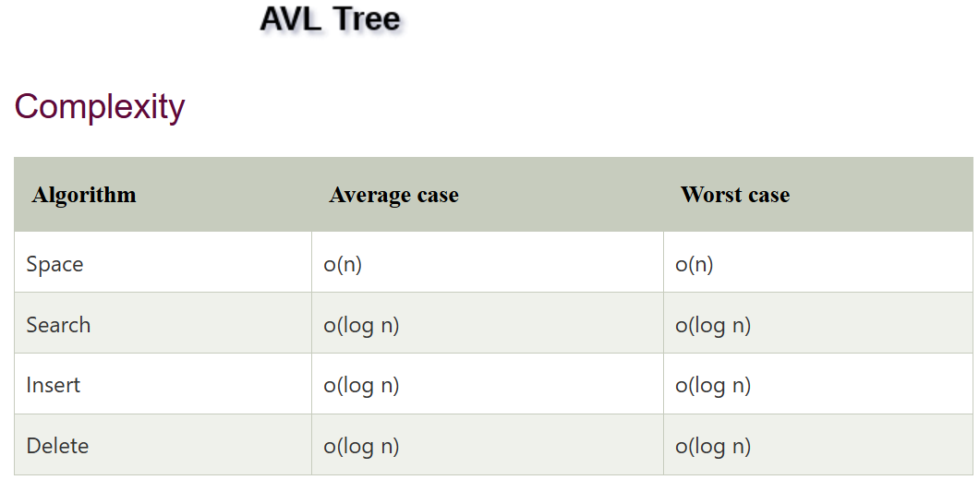

Slide 38
Rotations
When the tree structure changes (e.g., insertion or deletion), we need to transform the tree to restore the AVL tree property.
This is done using single rotations or double rotations.
e.g. Single Rotation
y
x
x
y
C
A
C
B
B
A
Before Rotation
After Rotation

Slide 39
Rotations
Since an insertion/deletion involves adding/deleting a single node, this can only increase/decrease the height of some subtree by 1
Thus, if the AVL tree property is violated at a node x, it means that the heights of left(x) and right(x) differ by exactly 2.
Rotations will be applied to x to restore the AVL tree property.

Slide 40
Insertion
First, insert the new key as a new leaf just as in ordinary binary search tree
Then trace the path from the new leaf towards the root. For each node x encountered, check if heights of left(x) and right(x) differ by at most 1.
If yes, proceed to parent(x). If not, restructure by doing either a single rotation or a double rotation [next slide].
For insertion, once we perform a rotation at a node x, we don’t need to perform any rotation at any ancestor of x.

Slide 41
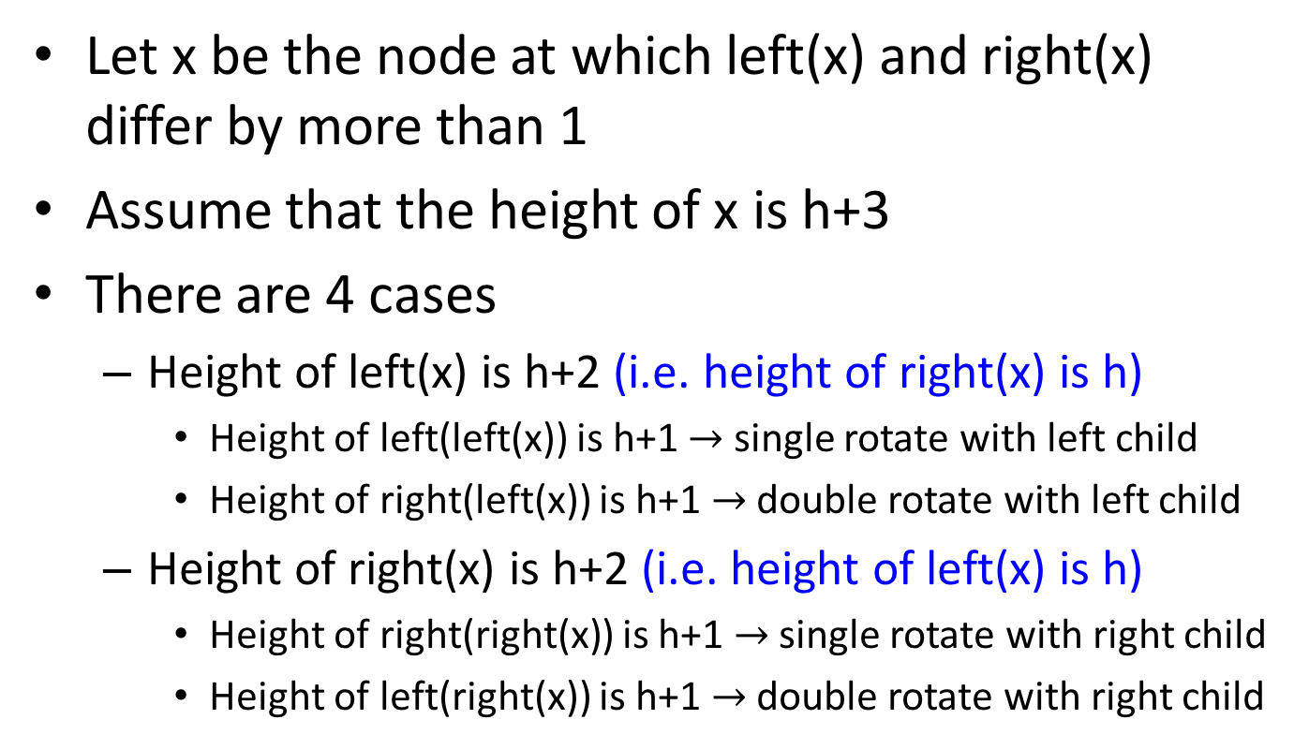
Insertion
Let x be the node at which left(x) and right(x) differ by more than 1
Assume that the height of x is h+3
There are 4 cases
Height of left(x) is h+2 (i.e. height of right(x) is h)
Height of left(left(x)) is h+1 $→$ single rotate with left child
Height of right(left(x)) is h+1 $→$ double rotate with left child
Height of right(x) is h+2 (i.e. height of left(x) is h)
Height of right(right(x)) is h+1 $→$ single rotate with right child
Height of left(right(x)) is h+1 $→$ double rotate with right child
Note: Our test conditions for the 4 cases are different from the code shown in the textbook. These conditions allow a uniform treatment between insertion and deletion.

Slide 42
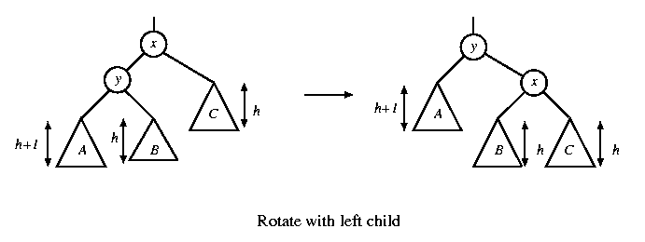
Single rotation in insertion
The new key is inserted in the subtree A.
The AVL-property is violated at x
height of left(x) is h+2
height of right(x) is h.

Slide 43
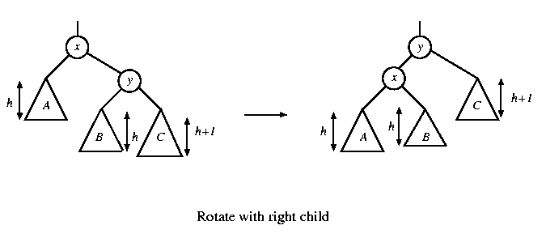
Single rotation in insertion
The new key is inserted in the subtree C.
The AVL-property is violated at x.
Single rotation takes O(1) time.
Insertion takes O(log N) time.

Slide 44
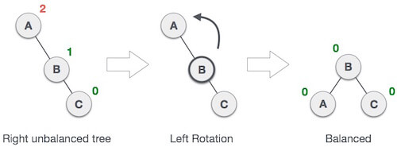
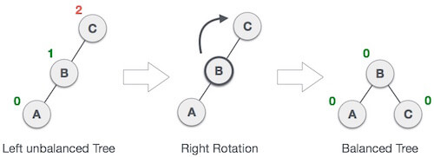

Slide 45
x
AVL Tree
5
5
y
8
C
3
3
8
1
4
B
1
4
A
0.8
Insert 0.8
3
5
1
After rotation
4
8
0.8

Slide 46
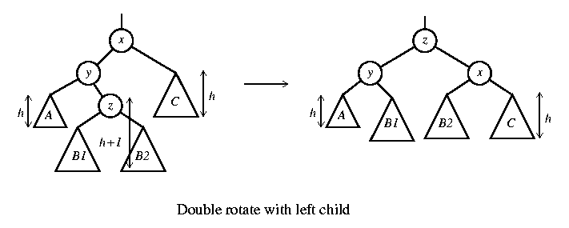
Double rotation in insertion
The new key is inserted in the subtree B1 or B2.
The AVL-property is violated at x.
x-y-z forms a zig-zag shape
also called left-right rotate

Slide 47
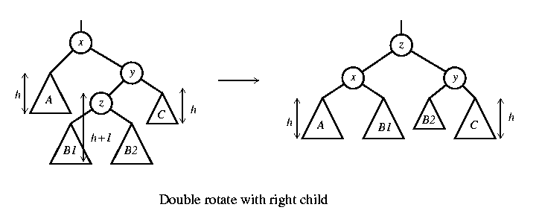
Double rotation in insertion
The new key is inserted in the subtree B1 or B2.
The AVL-property is violated at x.
also called right-left rotate

Slide 48
x
5
AVL Tree
5
C
y
8
3
3
8
A
1
4
z
1
4
B
3.5
Insert 3.5
4
5
3
3.5
8
After Rotation
1

Slide 49
An Extended Example
Insert 3,2,1,4,5,6,7, 16,15,14
Single rotation
3
2
3
3
2
1
Fig 1
2
3
Fig 4
Fig 2
2
1
2
Single rotation
Fig 3
1
1
3
3
Fig 5
Fig 6
4
4
5

Slide 50
2
2
Single rotation
1
4
1
4
3
5
3
5
Fig 8
Fig 7
6
4
4
Single rotation
2
5
2
5
1
3
6
1
3
6
4
Fig 9
Fig 10
7
2
6
1
3
7
5
Fig 11

Slide 51
4
2
6
1
3
7
5
16
Fig 12
4
Double rotation
4
2
6
2
6
1
3
7
1
3
15
5
16
5
16
Fig 13
7
15
Fig 14

Slide 52
4
4
Double rotation
2
6
2
7
15
1
3
15
1
3
5
6
16
7
5
14
16
Fig 15
14
Fig 16

Slide 53
Deletion
Delete a node x as in ordinary binary search tree. Note that the last node deleted is a leaf.
Then trace the path from the new leaf towards the root.
For each node x encountered, check if heights of left(x) and right(x) differ by at most 1. If yes, proceed to parent(x). If not, perform an appropriate rotation at x. There are 4 cases as in the case of insertion.
For deletion, after we perform a rotation at x, we may have to perform a rotation at some ancestor of x. Thus, we must continue to trace the path until we reach the root.

Slide 54
Deletion
On closer examination: the single rotation for deletion can be divided into 4 cases (instead of 2 cases)
Two cases for rotate with left child
Two cases for rotate with right child

Slide 55
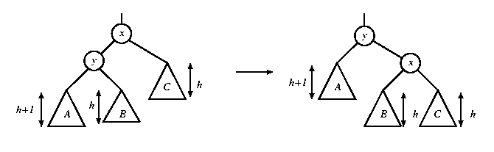
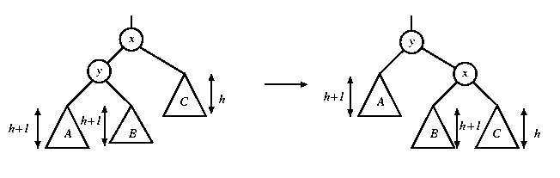
Single rotation in deletion
In both figures, a node is deleted in subtree C, causing the height to drop to h. The height of y is h+2. When the height of subtree A is h+1, the height of B can be h or h+1. Fortunately, the same single rotation can correct both cases.
rotate with left child

Slide 56
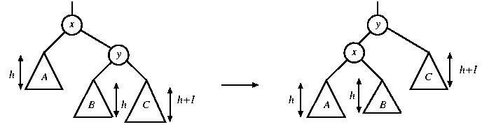
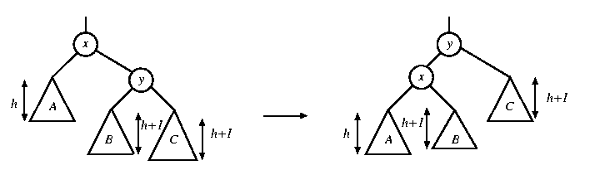
Single rotation in deletion
In both figures, a node is deleted in subtree A, causing the height to drop to h. The height of y is h+2. When the height of subtree C is h+1, the height of B can be h or h+1. A single rotation can correct both cases.
rotate with right child

Slide 57
Rotation in deletion
There are 4 cases for single rotations, but we do not need to distinguish among them.
There are exactly two cases for double rotations (as in the case of insertion)
Therefore, we can reuse exactly the same procedure for insertion to determine which rotation to perform

Slide 58
Deletion
9
5
Delete 12
5
12
3
9
Single rotation
3
8
11
1
2
8
11
1
2

Slide 59
Deletion
9
8
Delete 12
5
12
5
9
double rotation
3
8
11
3
6
11
1
6
1

